Slide 1

1
Page
การเขียนโปรแกรมไพธอน
สำหรับวิศวกรข้อมูล
Basic Python for Data Sci

Slide 2
2
Page
สิ่งที่ต้องจัดเตรียม และความรู้พื้นฐาน
คอมพิวเตอร์ หรือ แล็ปท็อป 1 เครื่อง
ผู้เข้าร่วมอบรมจะต้องติดตั้งโปรแกรม
ผู้เข้าร่วมอบรมต้องมีความรู้พื้นฐานการเขียนโปรแกรมภาษา Python และ SQL
ผู้เข้าร่วมอบรมต้องมีความรู้ขั้นพื้นฐานเกี่ยวกับ Database และเขียนคำสั่ง Command Line ได้

Slide 3
3
Page
สารบัญ
Part 1: เริ่มต้นกับ Python
Data types
Operators
Conditionals
Iteration
Built in data structures (Lists, Dictionaries)
Part 2: การเขียนโปรแกรมเชิงวัตถุ (Object oriented)
Python – Defining classes
Understanding inheritance
Understanding the concept of. Encaptulation
Understanding abstraction and abstract data types (ADTs)
Understanding polymorphism
Part 3: HEI Integrated Data Hub
ภาพรวมของโครงการ HEI Integrated Data Hub
การใช้งานเครื่องมือ Apache Airflow
วิธีการนำเข้าข้อมูลโดยใช้เครื่องมือ Apache Airflow

Slide 4
Part 1 เริ่มต้นกับ Python
Review of:
Data types
Operators
Conditionals
Iteration
Built in data structures (Lists, Dictionaries)

Slide 5
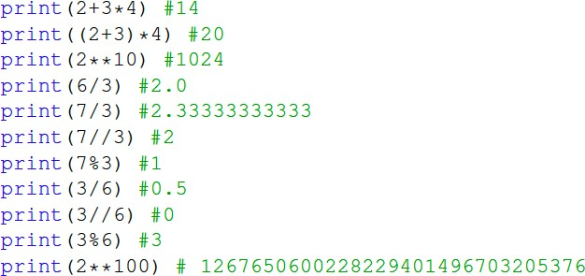
5
Page
Data Types
Python has two main built-in numeric classes that implement the integer and floating point data types.
int and float.
The standard arithmetic operations are +, −, *, /, and ** (exponentiation)
Other very useful operations are the remainder (modulo) operator,
Notes:
แก้ไข

Slide 6
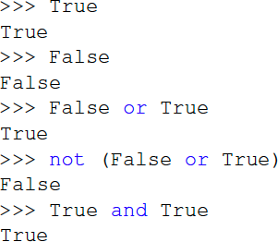
6
Page
Data Types
The boolean data type, implemented as the Python bool class, will be quite useful for representing truth values.
The possible state values for a boolean object are True and False with the standard boolean operators, and, or, and not
Notes:
แก้ไข

Slide 7
7
Page
Data Types
The boolean data type, implemented as the Python bool class, will be quite useful for representing truth values.
The possible state values for a boolean object are True and False with the standard boolean operators, and, or, and not
Notes:
แก้ไข

Slide 8
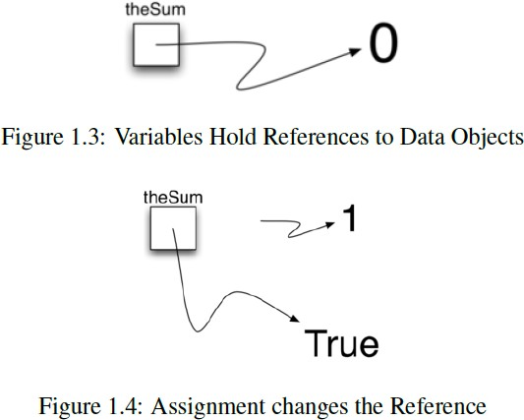
8
Page
Data Types
Python considers data to be the focal point of the problem-solving process
In Python, as well as in any other object- oriented programming language, we define a class to be a description of what the data look like (the state) and what the data can do (the behavior).
Classes are analogous to abstract data types because a user of a class only sees the state and behavior of a data item.
Notes:
แก้ไข

Slide 9
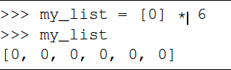
9
Page
Python Lists
Since lists are considered to be sequentially ordered, they support a number of operations thatcan be applied to any Python sequence.
Note that the indices for lists (sequences) start counting with 0.
The slice operation, my_list[1 : 3], returns a list of items starting with the item indexed by 1 up to but not including the item indexed by 3.
Sometimes, you will want to initialize a list. This can quickly be accomplished by using repetition.
Notes:
แก้ไข

Slide 10
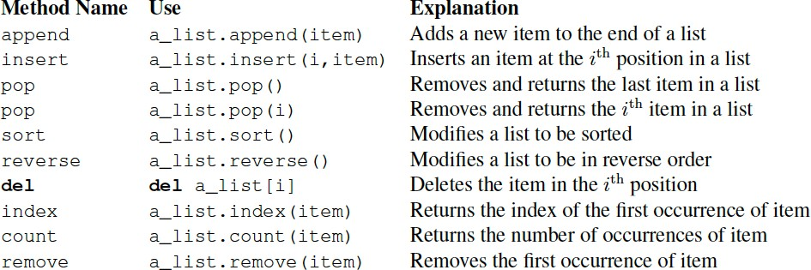
10
Page
Working with Lists
Notes:
แก้ไข

Slide 11
11
Page
Working With Lists
You can see that some of the methods, such as pop, return a value and also modify the list.
Others, such as reverse, simply modify the list with no return value.
pop will default to the end of the list but can also remove and return a specific item.
The index range starting from 0 is again used for these methods.
You should also notice the familiar “dot” notation for asking an object to invoke a method.
my_list.append(False) # append the value “False” to the end of the list
Notes:
แก้ไข

Slide 12
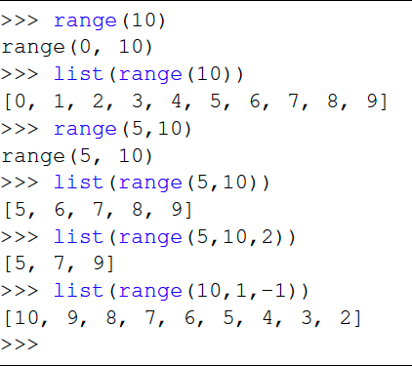
12
Page
Range Object
function. range produces a range object that represents a sequence of values.
By using the list function, it is possible to see the value of the range object as a list. This is illustrated on the right
The range object represents a sequence of integers. By default, it will start with
0. If you
provide more parameters, it will start and end at particular points and can even skip items
Notes:
แก้ไข

Slide 13
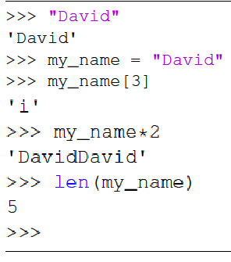
13
Page
Working With Strings
Strings are sequential collections of zero or more letters, numbers and other symbols.
We call these letters, numbers and other symbols characters.
Literal string values are differentiated from identifiers by using quotation marks (either single or double).
Notes:
แก้ไข

Slide 14
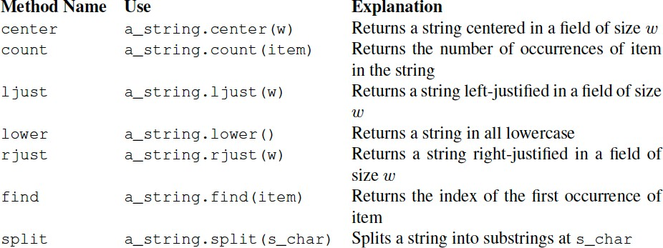
14
Page
String Methods
Notes:
แก้ไข

Slide 15
15
Page
Mutability vs Immutability
A major difference between lists and strings is that lists can be modified while strings cannot.
This is referred to as mutability.
Lists are mutable; strings are immutable.
For example, you can change an item in a list by using indexing and assignment.
With a string that change is not allowed.
Notes:
แก้ไข

Slide 16
16
Page
Working With Tuples
Tuples are very similar to lists in that they are heterogeneous sequences of data.
The difference is that a tuple is immutable, like a string.
A tuple cannot be changed.
Tuples are written as comma-delimited values enclosed in parentheses.
As sequences, they can use any operation that a list can
However, if you try to change an item in a tuple, you will get an error.
Notes:
แก้ไข

Slide 17
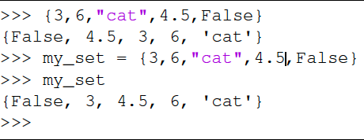
17
Page
Working With Sets
A set is an unordered collection of zero or more immutable Python data objects.
Sets do not allow duplicates and are written as comma-delimited values enclosed in curly braces.
The empty set is represented by set().
Sets are heterogeneous, and the collection can be assigned to a variable, as shown on the right
Notes:
แก้ไข

Slide 18
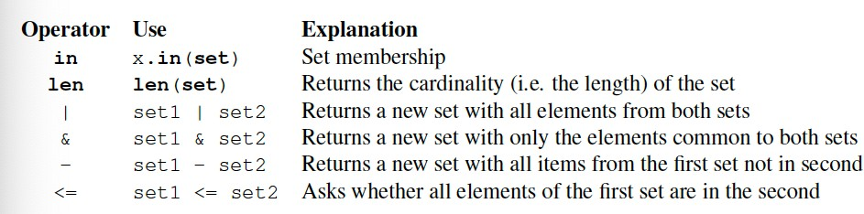
18
Page
Set Operations
Notes:
แก้ไข

Slide 19
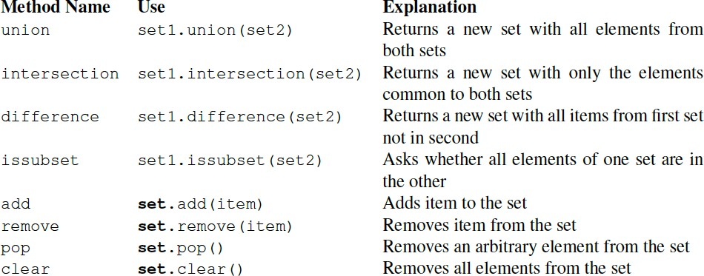
19
Page
Set Methods
Notes:
แก้ไข

Slide 20
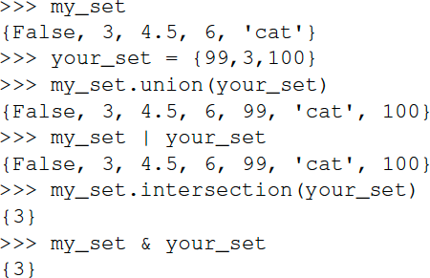
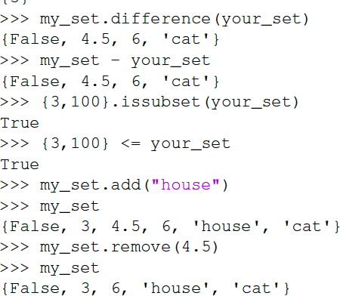
20
Page
Set Examples
Notes:
แก้ไข

Slide 21
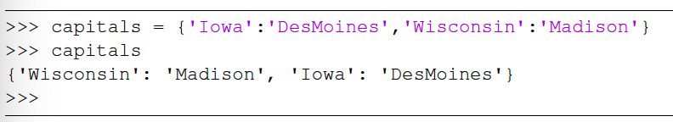
21
Page
Working with Dictionaries
Dictionaries are unordered structures that consist of collections of associated pairs of items
Each pair consists of a key anda. Value
This key-value pair is typically written as key:value
Dictionaries are written as comma-delimited key:avlue pairs enclosed in curly braces:
Notes:
แก้ไข

Slide 22
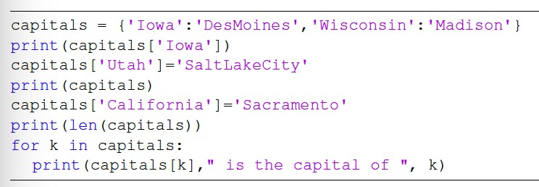
22
Page
Working with Dictionaries
We can manipulate a dictionary by accessing a value via its key or by adding another key-value pair.
The syntax for access looks much like a sequence access except that instead of using the index of the item we use the key value.
Notes:
แก้ไข

Slide 23
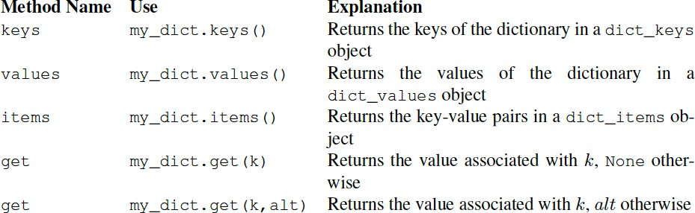
23
Page
Working With Dictionaries
It is important to note that the dictionary is maintained in no particular order with respect to the keys.
Dictionary Methods:
Notes:
แก้ไข

Slide 24
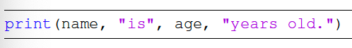
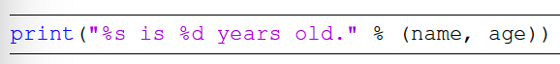
24
Page
Formatting Output
It is often useful to have more control over the look of your output.
Python provides us with an alternative called formatted strings.
A formatted string is a template in which words or spaces are combined with placeholders for variables that will be inserted into the string.
An example:
Notes:
แก้ไข

Slide 25
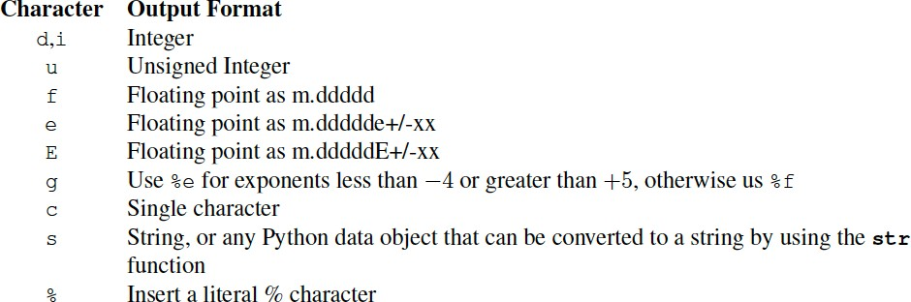
25
Page
String Formatting Conversion Characters
Notes:
แก้ไข

Slide 26
26
Page
Control Structures
Algorithms require two important control structures:
iteration and selection.
Both of these are supported by Python in various forms.
The programmer can choose the best statement for the given circumstance
For iteration, Python provides a while and for statement
The while statement repeats a body of code as long as a condition is true
The for statement can be used to iterate over the members of a collection
Notes:
แก้ไข

Slide 27
27
Page
While Loop
The while statement is used in a number of different algorithms.
In many cases, a compound condition will control the iteration. For example:
while counter <= 10 and not done:
This code would cause the body of the statement to be executed only in the case where both parts of the condition are satisfied.
The value of the variable counter would need to be less than or equal to 10 and the value of the variable done would need to be False (not False is True) so that True and True results in True.
Notes:
แก้ไข

Slide 28
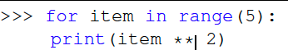
28
Page
For Loop
The for statement, can be used in conjunction with many of the Python collections.
The for statement can be used to iterate over the members of a collection, so long as the collection is a sequence
A common use of the for statement is to implement definite iteration over a range of values.
The range function will return a range object representing the sequence:
Notes:
แก้ไข

Slide 29
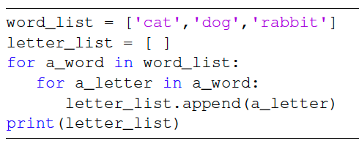
29
Page
Complex Iteration
The example shown processes each character of a string
Processes each character by appending it to a list
Each word is parsed to extract each character in the list. The result is shown below
Notes:
แก้ไข

Slide 30
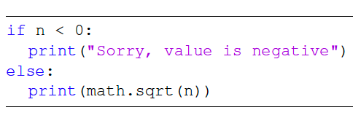
30
Page
Conditionals: if/else
Selection statements allow programmers to ask questions and then, based on the result, perform different actions.
Most programming languages provide two versions of this useful construct:
the ifelse and the if.
A simple example of a binary selection uses the ifelse:
Notes:
แก้ไข

Slide 31
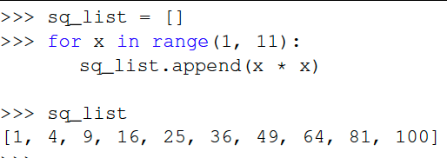
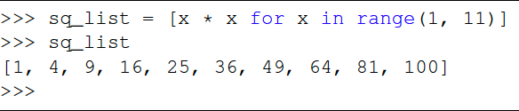
31
Page
List Comprehension
Returning to lists, there is an alternative method for creating a list that uses iteration and selection constructs.
List Comprehension - A list comprehension allows you to easily create a list based on some processing or selection criteria. For example:
If we would like to create a list of the first 10 perfect squares, we could use a for statement
Notes:
แก้ไข

Slide 32
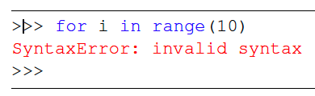
32
Page
Exception Handling
There are two types of errors that typically occur when writing programs.
The first, known as a syntax error, simply means that the programmer has made a mistake in the structure of a statement or expression
The other type of error is a logic error – the program executes but gives the wrong result (often manifests as a run-time error (ie. Divide by zero)
These types of runtime errors are called exceptions
Notes:
แก้ไข

Slide 33
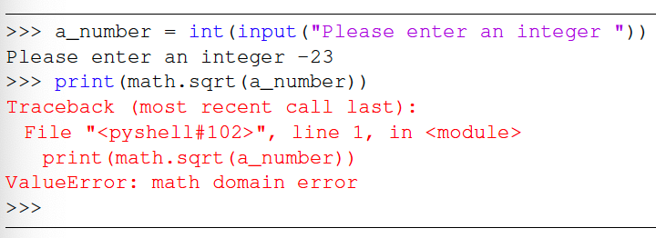
33
Page
Handling Exceptions
When an exception occurs, we say that it has been “raised.”
The code on the right asks the user for an integer and then calls the square root function from the math library.
If the user enters a value that is greater than or equal to 0, the print will show the square root.
If the user enters a negative value, the square root function will report a ValueError exception
Notes:
แก้ไข

Slide 34
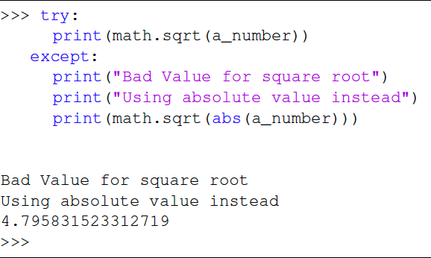
34
Page
Handling Exceptions
We can handle this exception by calling the print function from within a try block.
A corresponding except block “catches” the exception and prints a message back to the user in the event that an exception occurs.
Much cleaner – gives us a meaningful message and an alternative value
Notes:
แก้ไข

Slide 35
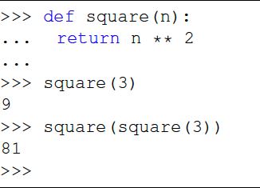
35
Page
Defining Functions
The syntax for a function definition includes the name and a parenthesized list of formal parameters.
For the function example on the right, n is the only formal parameter
The details, hidden “inside the box,” compute the result of n ** 2 and return it.
We can invoke or call the square function by asking the Python environment to evaluate it, passing an actual parameter value, in this case, 3.
Notes:
แก้ไข

Slide 36
36
Page
Summary
Today we reviewed some Python programming concepts:
Data types
Operators
Conditionals
Iteration
Built-in Data Types (Lists, Dictionaries)
NEXT WEEK 7 More Python Review - Classes
Notes:
แก้ไข

Slide 37
Part 2: การเขียนโปรแกรมเชิงวัตถุ (Object oriented)
Python – Defining classes
Understanding inheritance
Understanding the concept of. Encapsulation
Understanding abstraction and abstract data types (ADTs)
Understanding polymorphism

Slide 38
38
Page
Intro
Review of Object oriented programming:
Python – Defining classes
Understanding inheritance
Understanding the concept of. Encapsulation
Understanding abstraction and abstract data types (ADTs)
Understanding polymorphism
Notes:
แก้ไข

Slide 39
39
Page
Python – Working with Classes
Python is an object oriented programming language
So far, we have seen that there are a number of built-in classes for data and control structures
One of the most powerful features in an object-oriented programming language is the ability to allow a programmer (problem solver) to create new classes that model data that is needed to solve the problem.
We use abstract data types to provide the logical description of what a data object looks like (its state) and what it can do (its methods).
Notes:
แก้ไข

Slide 40
40
Page
Defining Classes
By building a class that implements an abstract data type, a programmer can take advantage of the abstraction process and at the same time provide the details necessary to actually use the abstraction in a program.
Whenever we want to implement an abstract data type, we will do so with a new class.
To better understand classes, let’s take a look at a concrete example.
A Fraction Class
Notes:
แก้ไข

Slide 41
41
Page
Fraction Class Example
A common example to show the details of implementing a user- defined class is to implement the abstract data type Fraction
A fraction consists of a numerator and a denominator – we would like to represent the fraction as an exact value
The operations for a Fraction type will allow a Fraction data object to behave like any other numeric value – we can add, subtract, multiply, and divide
In Python we define a new class by providing a name and a set of method definitions
Notes:
แก้ไข

Slide 42
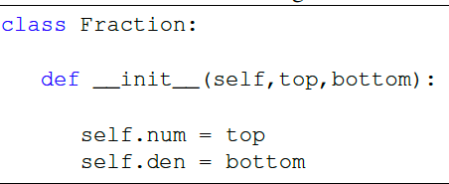
42
Page
Fraction Class Example
The first method that all classes should provide is a constructor
Notice that the formal parameter list contains three items (self, top, bottom).
self is a special parameter that will always be used as a reference back to the object itself.
It must always be the first formal parameter; however, it will never be given an actual parameter value upon invocation.
top, bottom are the numerator, denominator
Notes:
แก้ไข

Slide 43
43
Page
Fraction Class Example
The notation self.num in the constructor defines the fraction object to have an internal data object called num as part of its state.
Likewise, self.den creates the denominator.
The values of the two formal parameters are initially assigned to the state,
This allows the new fraction object to know its starting value. (initialization)
Notes:
แก้ไข

Slide 44
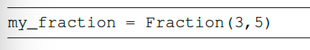
44
Page
Fraction Class Example
To create an instance of the Fraction class, we must invoke the constructor.
This happens by using the name of the class and passing actual values for the necessary state
note that we never directly invoke init
An object called my_fraction is created with a value of 3/5
Notes:
แก้ไข

Slide 45
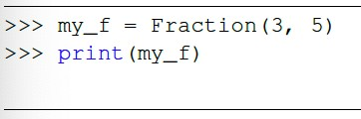
45
Page
Fraction Class Example
Now let’s say we wanted to display the fraction that we have created
Simply typing print(my_function) will not work:
We need to convert the object to a string before it can be written to output
There are 2 ways we can solve this problem – create a function or override a function that is there
Notes:
แก้ไข

Slide 46
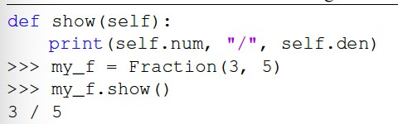
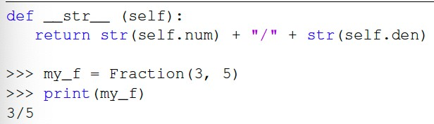
46
Page
Fraction Class Example
First, let’s create a function called show() that allows the
Fraction object to print itself as a string:
The other option is to override the str method that converts an object into a string
Notes:
แก้ไข

Slide 47
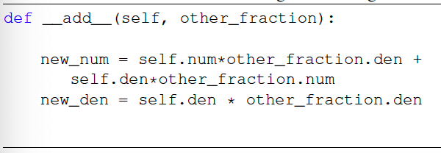
47
Page
Fraction Class Example
We can also override any other methods that we need, for example,
add
Our Fraction object now has two useful methods, and we can add on additional methods as needed.
Notes:
แก้ไข

Slide 48
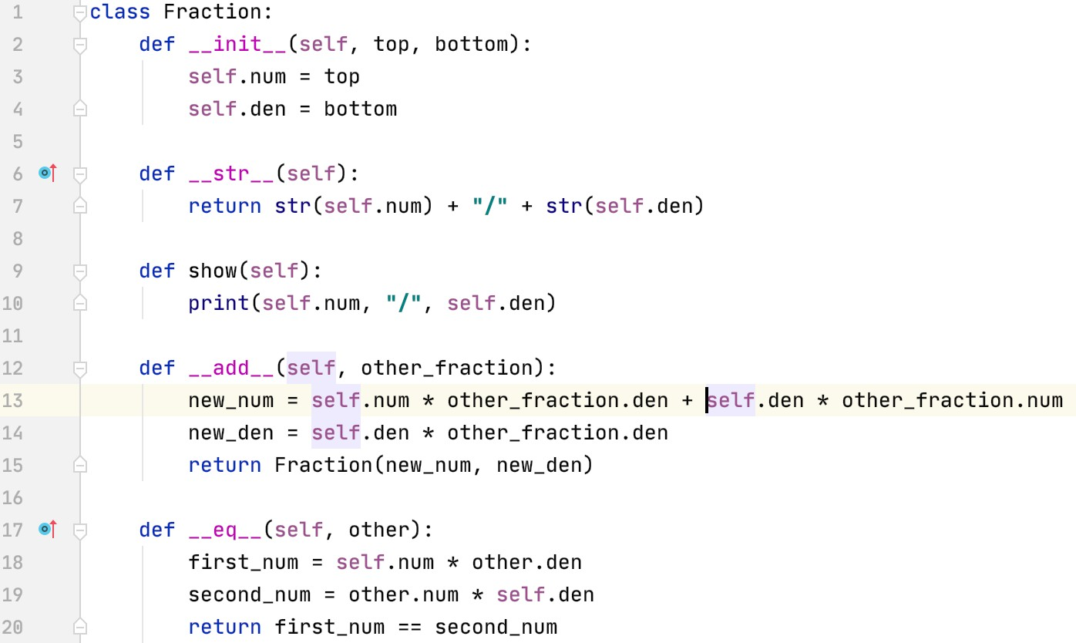
48
Page
Fraction Class Example
Notes:
แก้ไข

Slide 49
49
Page
Data Processing with Class
A class is useful for modeling a real-world object with complex behavior.
Another common use for objects is to group together a set of information that describes a person or thing.
Eg., a company needs to keep track of information about employees (an Employee class with information such as employee’s name, social security number, address, salary, etc.)
Notes:
แก้ไข

Slide 50
50
Page
Data Processing with Class
A grouping of information like this is often called a record.
Let’s try a simple data processing example!
A typical university measures courses in terms of credit hours, and grade point averages are calculated on a 4 point scale where an “A” is 4 points, a “B” is three, etc.
Notes:
แก้ไข

Slide 51
51
Page
Data Processing with Class
Grade point averages are generally computed using quality points.
If a class is worth 3 credit hours and the student gets an “A”, then he or she earns
3(4) = 12 quality points.
To calculate the GPA, we divide the total quality points by the number of credit hours completed.
Notes:
แก้ไข

Slide 52
52
Page
Data Processing with Class
Suppose we have a data file that contains student grade information.
Each line of the file consists of a student’s name, credit-hours, and quality points.
Adams, Henry | 127 | 228
Comptewell, Susan | 100 | 400
DibbleBit, Denny | 18 | 41.5
Jones, Jim | 48.5 | 155
Smith, Frank | 37 | 125.33
Notes:
แก้ไข

Slide 53
53
Page
Data Processing with Class
Our job is to write a program that reads this file to find the student with the best GPA and print out their name, credit-hours, and GPA.
The place to start? Creating a Student class!
We can use a Student object to store this information as instance variables.
Notes:
แก้ไข

Slide 54
54
Page
Data Processing with Class
class Student:
def init (self, name, hours, qpoints): self.name = name
self.hours = float(hours) self.qpoints = float(qpoints)
The values for hours are converted to float to handle parameters that may be floats, ints, or strings.
To create a student record:
aStudent = Student("Adams, Henry", 127, 228)
The coolest thing is that we can store all the information about a student in a single variable!
Notes:
แก้ไข

Slide 55
55
Page
Data Processing with Class
We need to be able to access this information, so we need to define a set of accessor methods.
def getName(self): return self.name
def getHours(self): return self.hours
def getQPoints(self): return self.qpoints
def gpa(self):
return self.qpoints/self.hours
For example, to print a student’s name you could write:
print aStudent.getName()
Notes:
แก้ไข

Slide 56
56
Page
Data Processing with Class
How can we use these tools to find the student with the best GPA?
We can use an algorithm similar to finding the max of n numbers! We could look through the list one by one, keeping track of the best student seen so far!
Notes:
แก้ไข

Slide 57
57
Page
Data Processing with Class
Get the file name from the user Open the file for reading
Set best to be the first student For each student s in the file
if s.gpa() > best.gpa set best to s
Print out information about best
Notes:
แก้ไข

Slide 58


58
Page
Data Processing with Class
def makeStudent(infoStr):
name, hours, qpoints = infoStr.split("\t") return Student(name, hours, qpoints)
# gpa.py - Program to find student with highest GPA class Student:
def init (self, name, hours, qpoints): self.name = name
self.hours = float(hours) self.qpoints = float(qpoints)
def main():
filename = input("Enter name the grade file: ") infile = open(filename, 'r')
best = makeStudent(infile.readline()) for line in infile:
s = makeStudent(line)
if s.gpa() > best.gpa(): best = s
infile.close()
print("The best student is:", best.getName()) print ("hours:", best.getHours()) print("GPA:", best.gpa())
def getName(self): return self.name
def getHours(self): return self.hours
def getQPoints(self): return self.qpoints
def gpa(self):
return self.qpoints/self.hours
main()
Notes:
แก้ไข

Slide 59
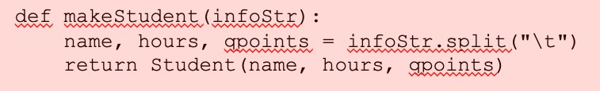
59
Page
Understanding makeStudent()
The makeStudent() method takes a line from the file and splits it into the three variables – name hours, gpoints
The line is split based on the TAB character “\t”
The method returns a newly created Student object
Notes:
แก้ไข

Slide 60
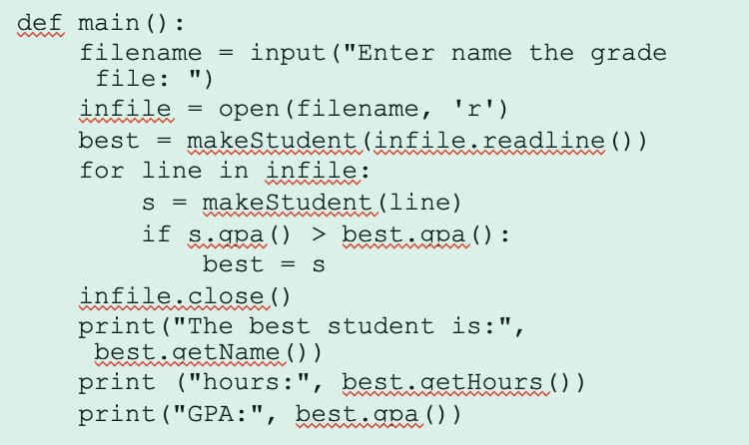
60
Page
Understanding main()
The file is opened (from filename)
A line is read from the file and passed to the makeStudent() function where it is returned as a Student object (best)
This initializes the best variable to the first Student object
The for loop now goes line-by-line in the file and makeStudent() is called, returning a Student object that is stored in the variable, s
The GPA of s (the current student) is then compared to the student with the best GPA and adjusted if need be
Once the loop is finished, the properties of the best student are displayed
Notes:
แก้ไข

Slide 61
61
Page
Encapsulating Encapsulation
The big lesson: using separate classes to encapsulate functionality makes the main program much simpler.
Encapsulation is one of the fundamental concepts in object-oriented programming (OOP).
It describes the idea of bundling data and methods that work on that data within one unit, e.g., a class in Python.
This concept is also often used to hide the internal representation, or state, of an object from the outside.
Notes:
แก้ไข

Slide 62
62
Page
Summary
Today we reviewed object-oriented programming with Python:
Python – Defining classes
Understanding inheritance
Understanding the concept of. Encaptulation
Understanding abstraction and abstract data types (ADTs)
Understanding polymorphism
Notes:
แก้ไข

Slide 63
Part 3: HEI Integrated Data Hub
ภาพรวมของโครงการ HEI Integrated Data Hub
การใช้งานเครื่องมือ Apache Airflow
วิธีการนำเข้าข้อมูลโดยใช้เครื่องมือ Apache Airflow

Slide 64






64
Page
แผนภาพแสดงภาพรวมของโครงการ
(1/3)
Transfer All Data by using Apache Airflow
MySQL
HEI
(THE, QS, UMR)
Data Lineage
Run DAGs
Data Discovery
Clean Data
Monitoring
Searching
Queries

Slide 65



65
Page
ทำความรู้จักกับ HEI
(2/3)
เป็นการเก็บรวบรวมข้อมูลการจัดอันดับมหาวิทยาลัยของทั้ง 3 เว็บไซต์ ได้แก่ U-Multirank,Times Higher Education, QS เพื่อนำข้อมูลเหล่านั้นมาใช้ประโยชน์ในด้านต่างๆ เช่น Employer Platform
Notes:
แก้ไข

Slide 66
66
Page
แหล่งที่มาของข้อมูล
(3/3)
สถาบันการจัดอันดับสถาบันอุดมศึกษาที่ได้รับทุนสนับสนุนจากสหภาพยุโรป
(The European Commission's Erasmus + Programme) และดำเนินการโดยนักวิชาการจากสถาบันการศึกษาต่างๆ ในทวีปยุโรป
U-MULTIRANK
Times Higher
Education
Times Higher Education หรือ THE องค์กรจัดอันดับมหาวิทยาลัยโลก จากประเทศอังกฤษ
Quacquarelli Symonds
การจัดอันดับมหาวิทยาลัยจากประเทศอังกฤษ โดย Quacquarelli Symonds (QS)

Slide 67

67
Page
การใช้งานเครื่องมือ Apache Airflow

Slide 68
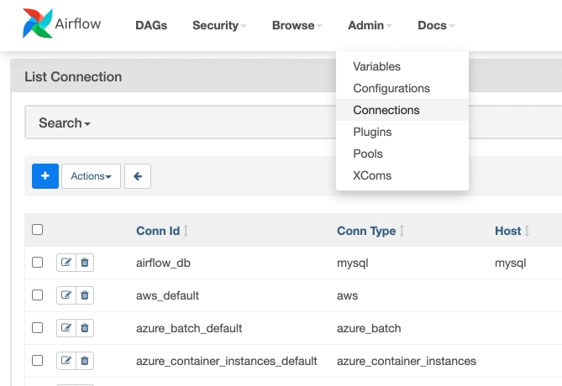
ทำไมต้องเป็น Apache Airflow
องค์กรต่างๆ ในปัจจุบันมีการนำข้อมูลจำนวนมหาศาลมาใช้ในการวิเคราะห์ข้อมูลให้เกิดประโยชน์สูงสุด การทำ Data pipeline จึงเป็นส่วนสำคัญที่ช่วยในการจัดการข้อมูลจำนวนมหาศาลนี้
Apache Airflow เครื่องมือสร้าง Data Pipeline ด้วย Python ที่ได้รับความนิยมในการทำ Workflow ที่เข้ามาจัดการ Task ต่าง ๆ โดยสามารถทำการ monitor workflow เพื่อดูสถานะการทำงานของแต่ละ task และ Duration time ที่เกิดขึ้นในการทำงานแต่ละ task ได้
Notes:
เกรินว่าทำไมถึงใช้ airflow ทำไม
บอกส่วนประกอบของ airflow ว่ามีอพไรบ้าง บอกว่า dag คืออะไร

Slide 69
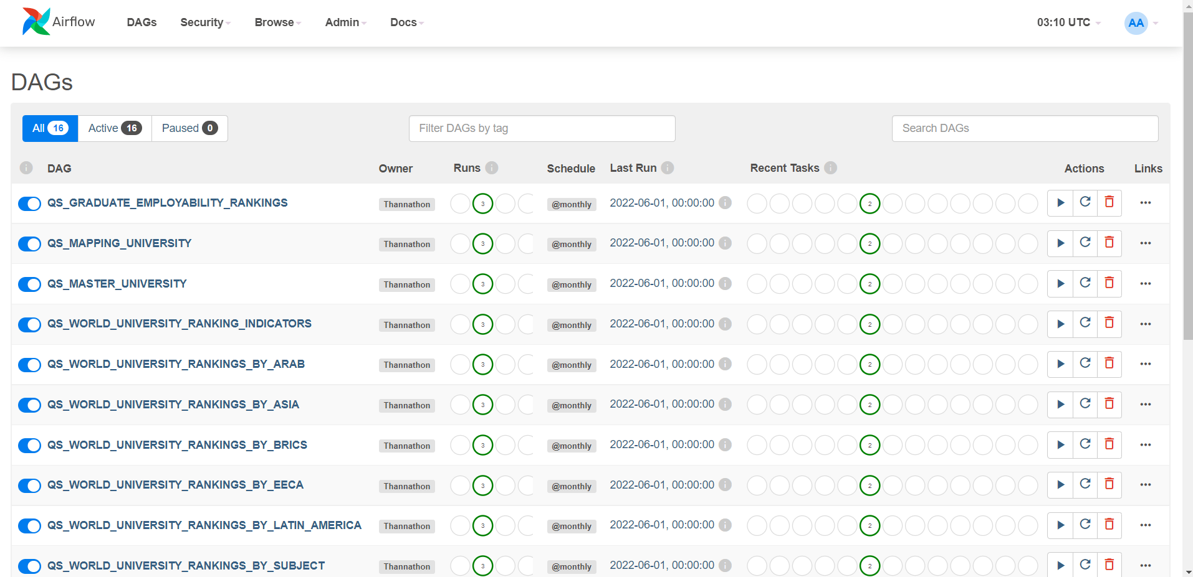
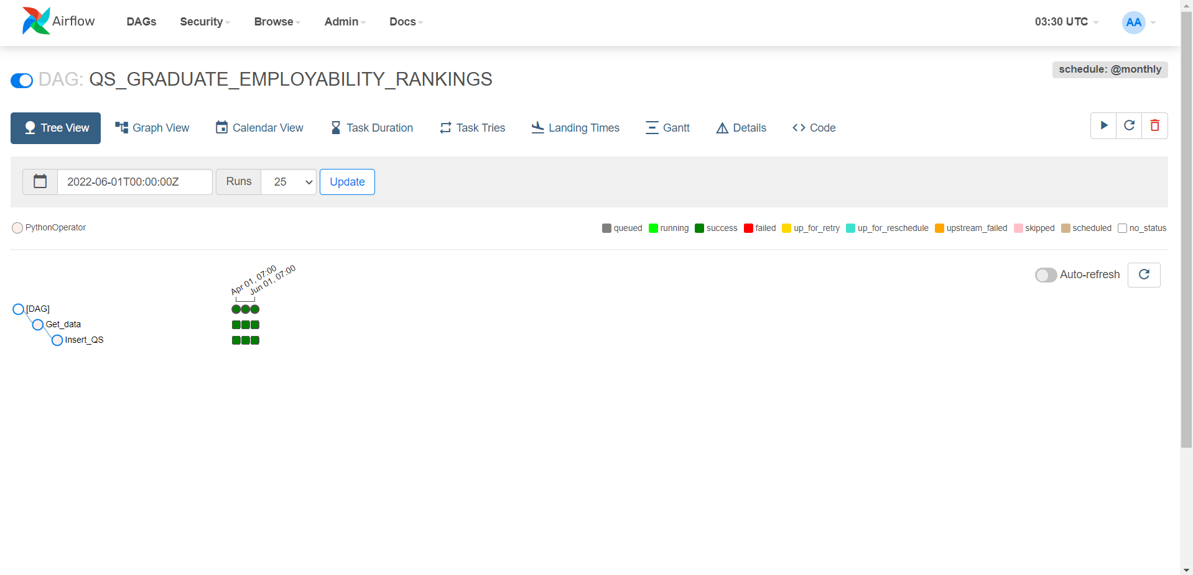
69
Page
ทำความรู้จักกับ Apache Airflow
(1/4)
เป็น Open Source ที่เข้ามาจัดการ Task งานต่างๆ โดยสามารถเขียนเป็น Python Code
มี Workflow ที่บอกทำงานแต่ละ Task ได้อย่างละเอียด
สามารถตั้งเวลาการทำงานแบบ Crontab (Cron Jobs) บน Linux ได้
มี Web UI ที่สามารถ Monitor Task Failure ที่เกิดขึ้นจากการทำงานในแต่ละ Task
ตั้งค่า Alert เมื่อมี Job Failures เกิดขึ้นได้
Job ใน Airflow จะเรียกว่า DAGs (Directed Acyclic Graphs)

Slide 70
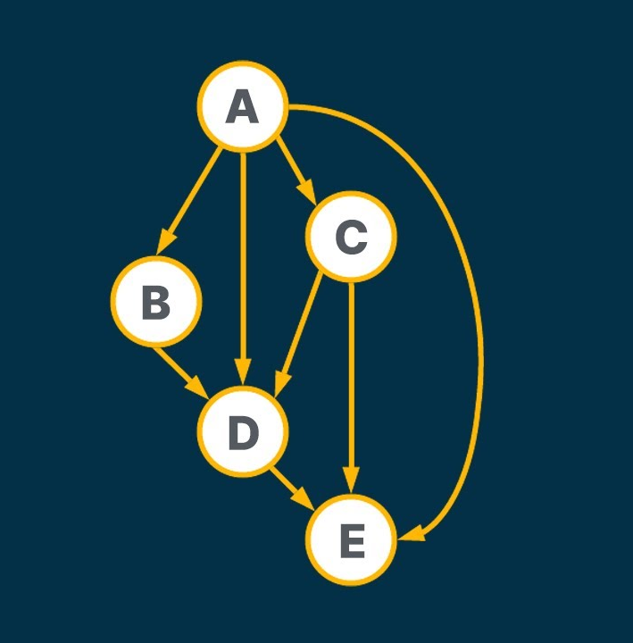
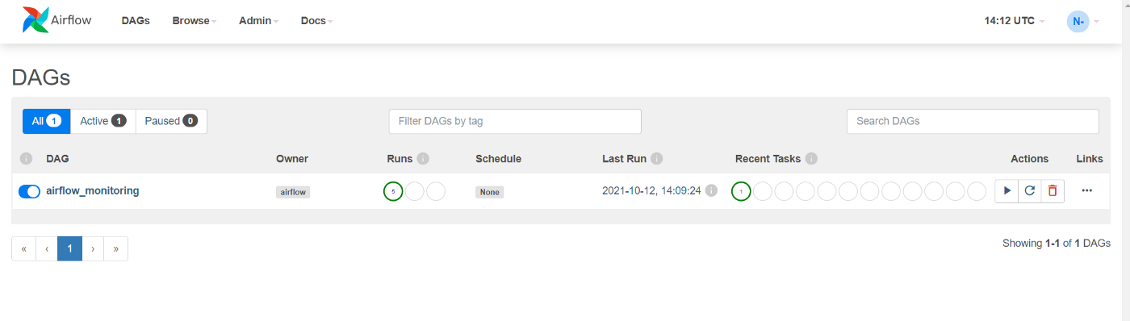
70
Page
ทำความรู้จักกับ Apache Airflow
(2/4)
DAG
Directed Acyclic Graph ประกอบไปด้วยหลายๆ Task ที่เชื่อมต่อกันและในแต่ละ Task นั้นก็มีความสามารถที่แตกต่างกัน ขึ้นอยู่กับการเขียน Code ของเรา

Slide 71
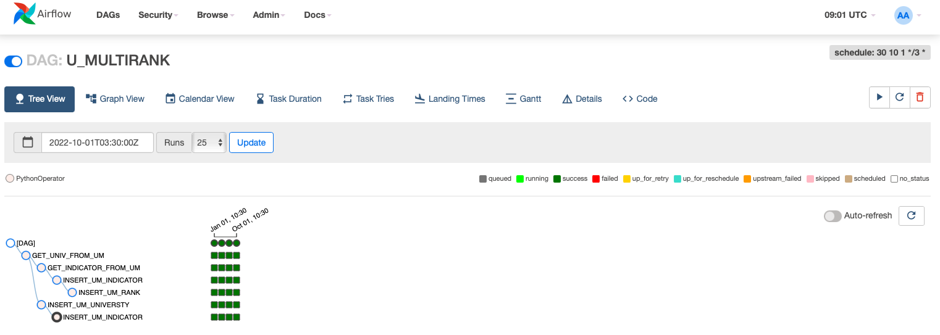
71
Page
ทำความรู้จักกับ Apache Airflow
(3/4)
Tree View
มุมมองที่แสดงถึง Task ของ DAG ในช่วงเวลาต่าง ๆ แต่ละคอลัมน์แสดงถึงการเรียกใช้ DAG และแต่ละช่องเป็น Instance ของ Task โดยแต่ละ Instance มีรหัสสีตามสถานะของ DAG Runs
Notes:
บนหน้า Web UI ของ Apache Airflow เราสามารถดูรายการของ DAGs ใน Environments ของเราได้ซึ่งช่วยให้เราจัดการ DAGs ต่าง ๆ ได้ง่ายยิ่งขึ้น และในหน้า Web UI เราสามารถใช้ฟังก์ชัน Graph view, Tree View เพื่อดูว่า Task ไหน Success หรือ Failure

Slide 72
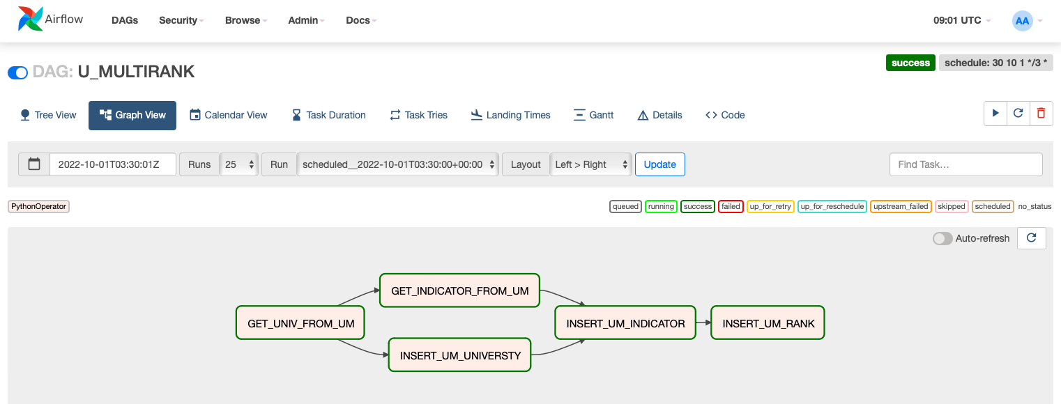
72
Page
ทำความรู้จักกับ Apache Airflow
(4/4)
Graph View
มุมมองที่แสดงถึง Task ที่ทำงานต่อกันใน DAG มุมมองนี้มีประโยชน์อย่างยิ่งเพราะสามารถใช้ตรวจทาน DAG ดู Flow การทำงานได้อย่างง่ายดายและมีสถานะบอกการทำงานของแต่ละ Task

Slide 73






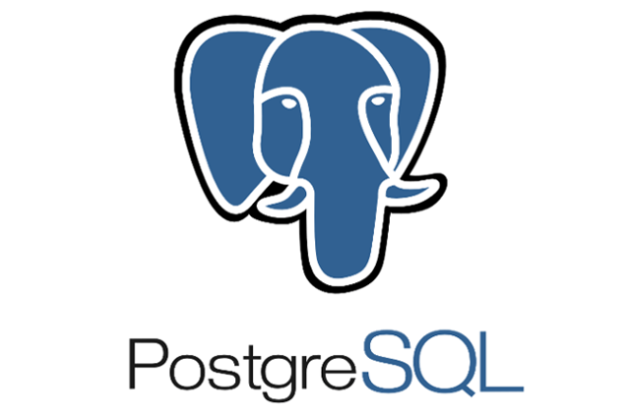

73
Page
Diagram แสดงภาพรวมการใช้งาน
Airflow Variables
DAG 1
Airflow Connection
DAG 2
DAG 3
Dynamic DAGs
DAG 4
:
DAG N
Web UI

Slide 74
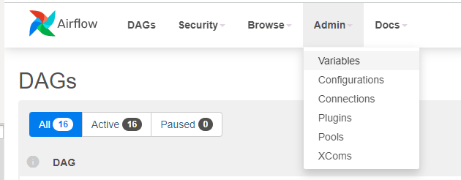
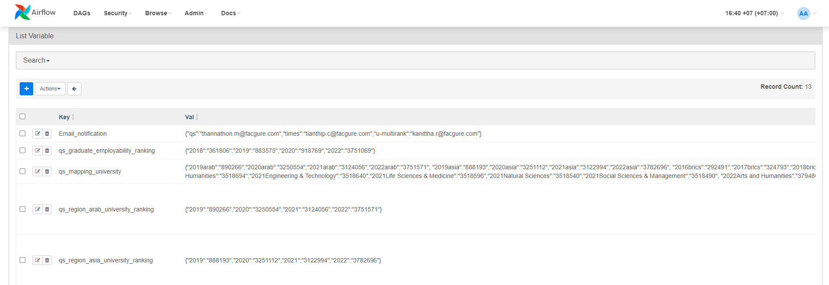
74
Page
การเก็บและการใช้งานตัวแปร (Variables)
(1/3)
Variables เป็นการกำหนดตัวแปรขึ้นเพื่อใช้งานในการเขียนคำสั่งของ DAGs โดยเก็บเป็น key value ภายใน Apache Airflow
1
เราสามารถกำหนด Variables ได้จากแถบเมนู Admin -> Variables
2
จะปรากฎหน้า List Variables จากนั้นให้กดรูปเครื่องหมาย “ + “ เพื่อเพิ่มรายการ Variables
Notes:
มี diagram บอกว่า variable เข้ามาใช้ ใน python

Slide 75
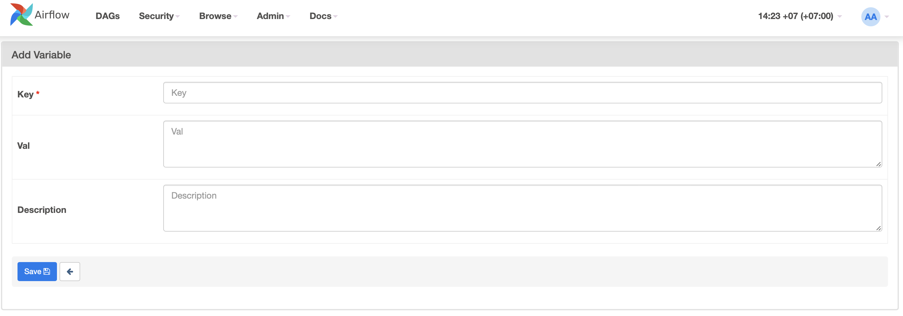
75
Page
การเก็บและการใช้งานตัวแปร (Variables)
(2/3)
3
จะปรากฎหน้าตั้งค่า Variable หลังจากกำหนดค่าให้ทำการกดที่ปุ่ม Save

Slide 76
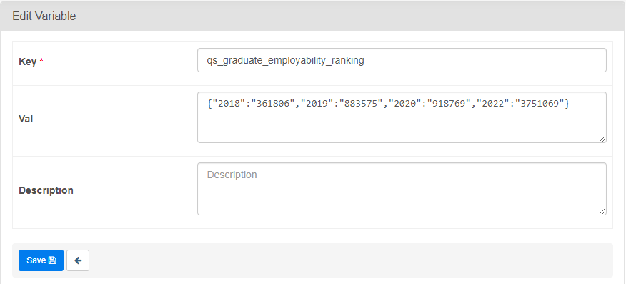
76
Page
การเก็บและการใช้งานตัวแปร (Variables)
(3/3)
สำหรับการแก้ไขให้เราเลือกรายการที่ต้องการแก้ไข หลังจากแก้ไขให้กดที่ปุ่ม Save
กด Edit Record จะแสดงหน้าต่าง
1
2

Slide 77
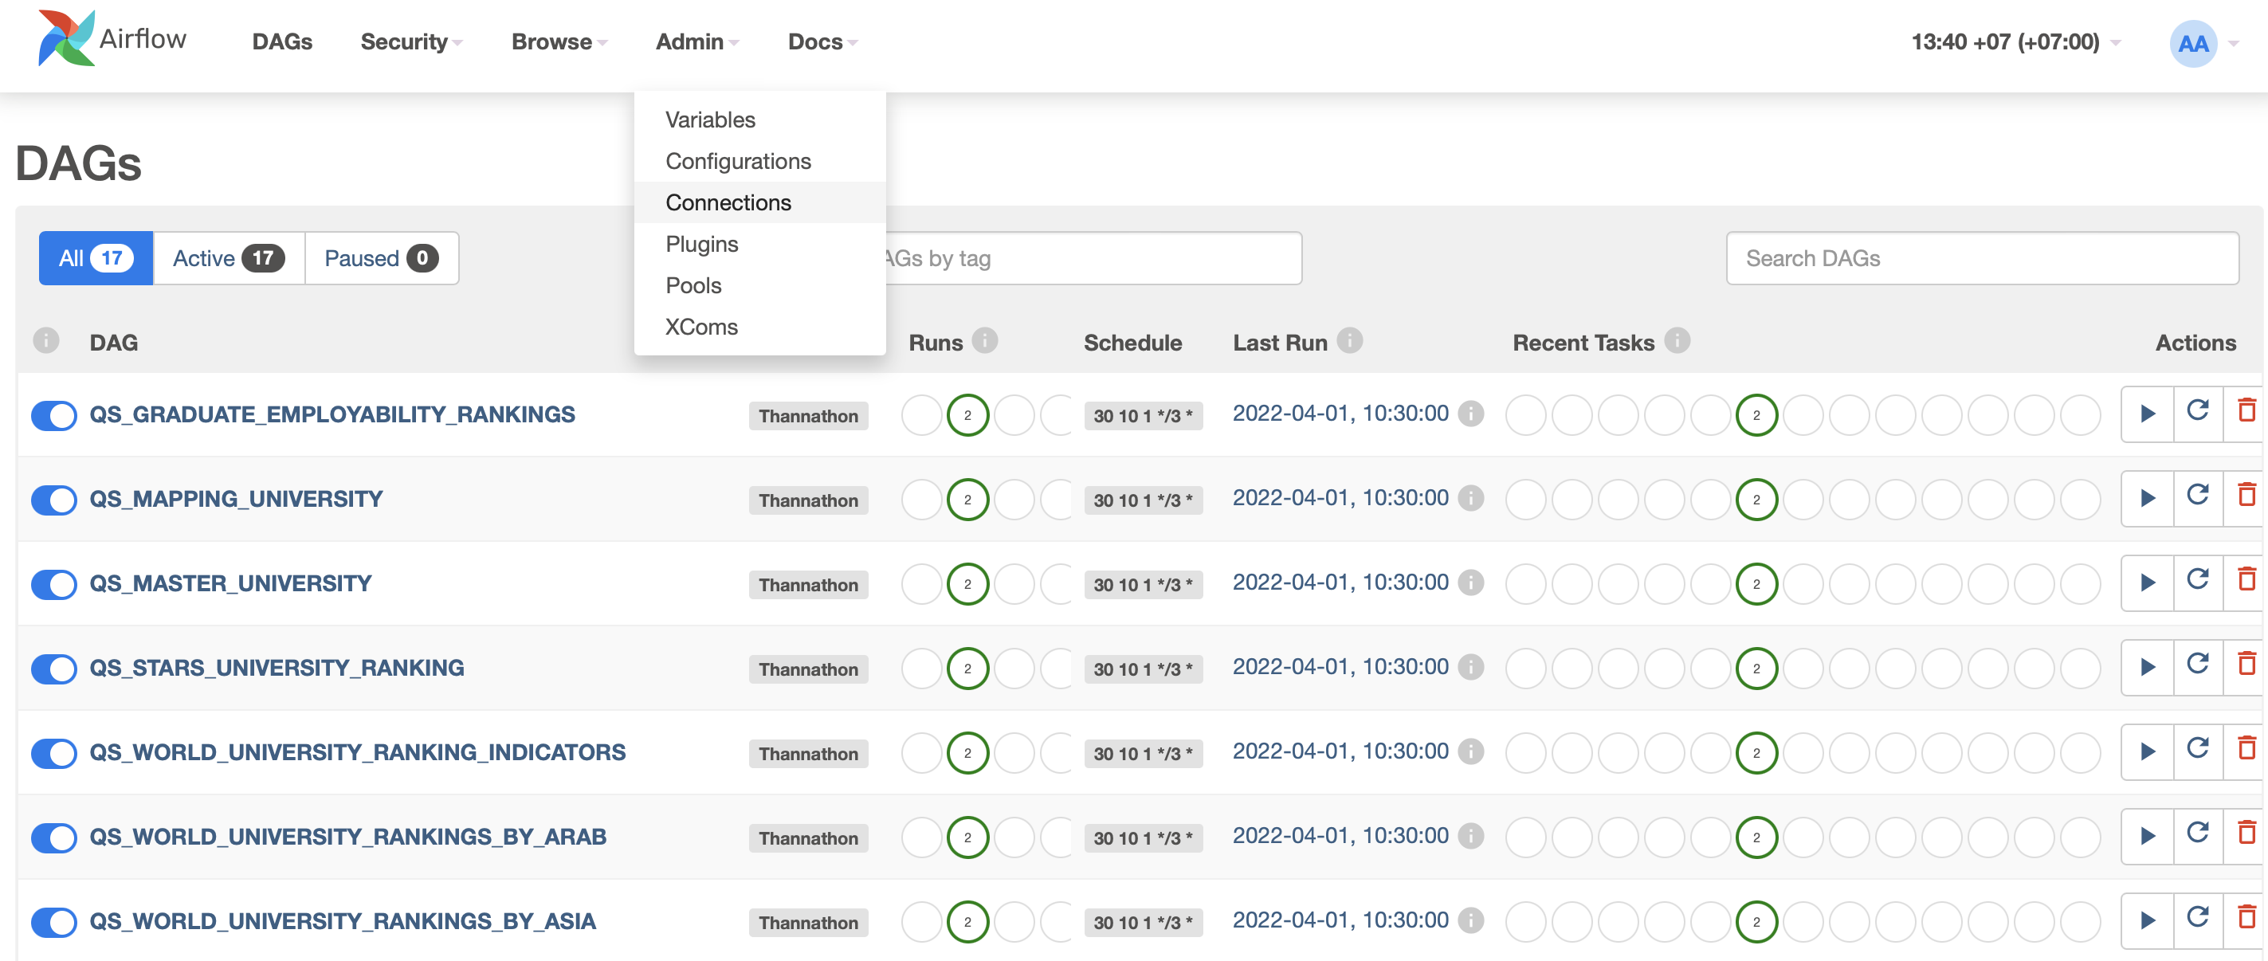

77
Page
วิธีการเชื่อมต่อข้อมูลกับ Apache Airflow
(1/2)
Connection สามารถเชื่อมต่อเครื่องมือภายนอกที่จะนำมาใช้งานใน DAG ได้อย่างหลากหลาย เช่น MySQL, PostgreSQL และ LinkedIn DataHub เป็นต้น
1
ทำการกำหนดได้ที่ แถบเมนู Admin -> Connections
2
จะปรากฎหน้า List Connection จากนั้นให้กดรูปเครื่องหมาย “ + “ เพื่อเพิ่มรายการที่เชื่อมต่อ
Notes:
บอกว่าทำ connecttion ไปเพื่ออะไร มีข้อดีอ่ะไร

Slide 78


78
Page
วิธีการเชื่อมต่อข้อมูลกับ Apache Airflow
(2/2)
3
จะปรากฎหน้าตั้งค่า Connection ให้เรากำหนด Conn id และ Conn Type ต่อไป

Slide 79
Thank You.

